Slide 1
Sensors Expo Demos Kanpai + Hidden Light Monitoring Demos
24 July 2017
US-CMS Applications Engineering

Slide 2
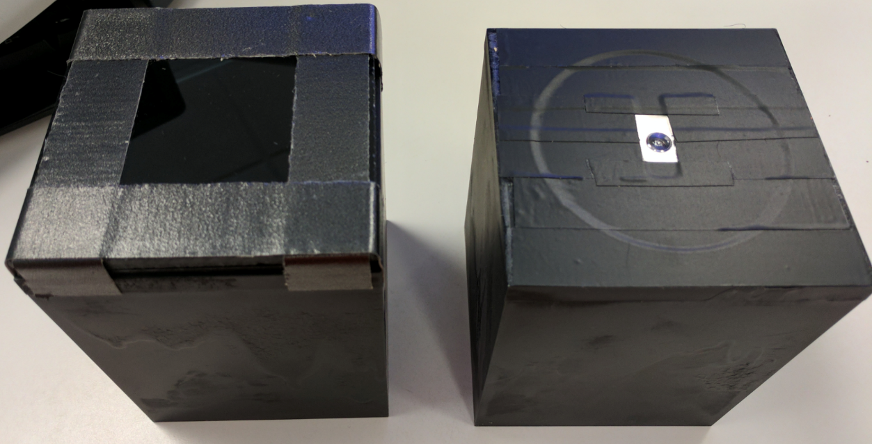
Summary
Kanpai Sensor : Demo to show how the BH1747 color sensor can identify “colors” of the object that is placed on the platform/coaster. Includes additional white LED with color sensor pairing.
Hidden Light Monitoring Sensor : Demo to show how the BH1747 works under 1% lighting conditions. Shows operation as ALS and as a color filter. Only BH1747 behind a 1% transparent glass
Hidden Light Monitoring
Kanpai Sensor Demo

Slide 3
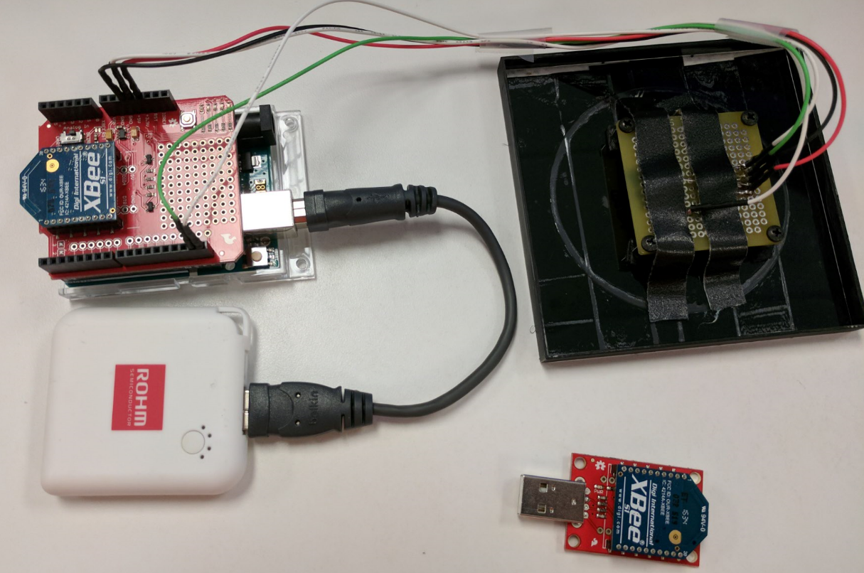
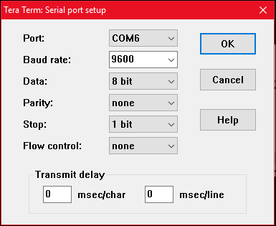
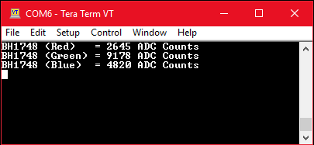
Kanpai Sensor Demo Setup
HW Used:
Arduino Uno
Xbee Shield
Xbee USB Dongle
Xbee Transceiver… x2
Breakout Board for LED+BH1747
Explanation:
I have setup the Xbee units to only send serial messages to each other. The USB dongle can be connected to a PC to open a COM port. Then will immediately start streaming data
Color Sensor is connected as follows:
BH1747 Vdd -> Arduino 3.3V
BH1747 GND -> Arduino GND
BH1747 SDA -> Arduino SDA
BH1747 SCL -> Arduino SDL
LED is also connected to the 5V source on the Arduino. A standard resistor divider is used to limit current to 5mA.

Slide 4
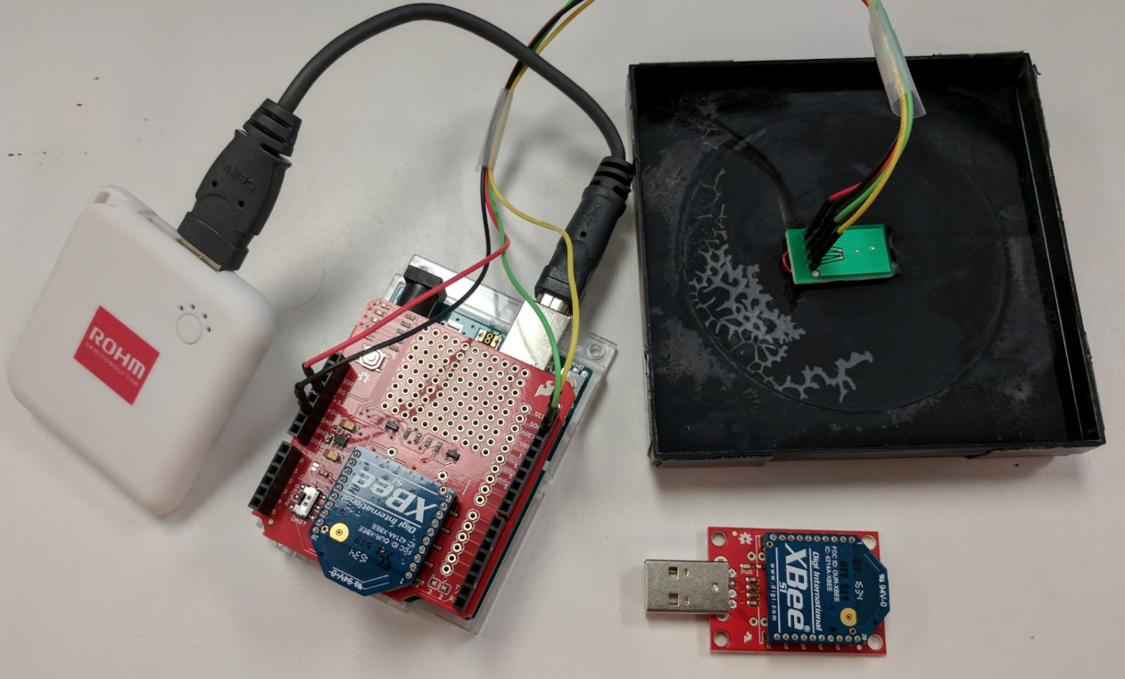
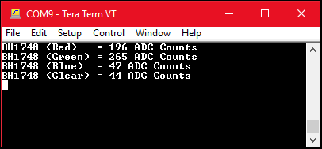
Hidden Light Monitoring Sensor Demo Setup
HW Used:
Arduino Uno
Xbee Shield
Xbee USB Dongle
Xbee Transceiver… x2
Breakout Board for BH1747 only
Explanation:
I have setup the Xbee units to only send serial messages to each other. The USB dongle can be connected to a PC to open a COM port. Then will immediately start streaming data
Color Sensor is connected as follows:
BH1747 Vdd -> Arduino 3.3V
BH1747 GND -> Arduino GND
BH1747 SDA -> Arduino SDA
BH1747 SCL -> Arduino SDL
There is no LED used in this demo, so you will need to use an external light source to properly show the operation of this demo
I also added the “clear” ALS return value to help show the ambient light portion of the demo.

Slide 5
Resources
GitHub Repository (Firmware)
https://github.com/ROHMUSDC/SensorExpo2017-Demo-KanpaiandHiddenLight
Xbee Helpful links
https://www.digi.com/products/xbee-rf-solutions/2-4-ghz-modules/xbee-zigbee
https://www.digi.com/products/xbee-rf-solutions/xctu-software/xctu
Arduino
https://store.arduino.cc/usa/arduino-uno-rev3
https://www.arduino.cc/en/Guide/HomePage
Tera Term
https://ttssh2.osdn.jp/index.html.en

